Slide 1
PGP-DSE-JUL-2022
INTERIM PRESENTATION

Slide 2
ABSTRACT
Batch details DSE – JUL 2022 (ONL)
Team members Nandakumar A K , Swetha R Ve , Narashimmhan R S ,
Jeeva Anand B , Muthurampandian R
Domain of Project Sales Analytics
Proposed Project title Unlocking Sales Potential in Lowa Liquor through
Data Analytics
Team Team 04
Team Leader Swetha R Ve
Mentor Name Pratik Sonar

Slide 3
PROBLEM STATEMENT
Lowa Liquor is a retail store that specializes in selling various types of alcoholic beverages. The store has been facing a decline in sales over the past year, and the management team is concerned about the reasons behind this decline. The store wants to identify the factors that are contributing to the decline in sales and find ways to improve the sales performance.
The purpose of the business is to identify the factors that are causing the decline in sales and develop strategies to increase sales revenue. The business wants to analyze sales data and customer behavior to identify patterns and trends that can help them make informed decisions about how to improve their business operations.

Slide 4
DATA DESCRIPTION
invoice_and_item_number | Invoice number for the purchased product
date | Date of the product purchase
store_number | Product sold store number
store_name | Product sold store name
address | Product sold store address
city | Product sold store city
zip_code | Product sold store zip code
store_location | Product sold store location
county_number | Product sold country number
County | Product sold country
Category | Category number of Product sold
category_name | Category name of Product sold
vendor_number | Vendor number for the product distributed to the stores
vendor_name | Vendor name for the product
item_number | item number for the product
item_description | Description of the item sold
Pack | Number of bottles in a pack
bottle_volume_ml | Quantity per bottle
state_bottle_cost | Cost of the bottle state wise (whole sale)
state_bottle_retail | Cost of the bottle retail
bottles_sold | Number bottle bought
sale_dollars | Price in dollar
volume_sold_liters | Quantity sold in litres

Slide 5
VARIABLE CATEGORIZATION
Independent variables:
Numerical column : 14
Categorical column : 10
Target variable :
Categorical : 01
Total columns : 24

Slide 6
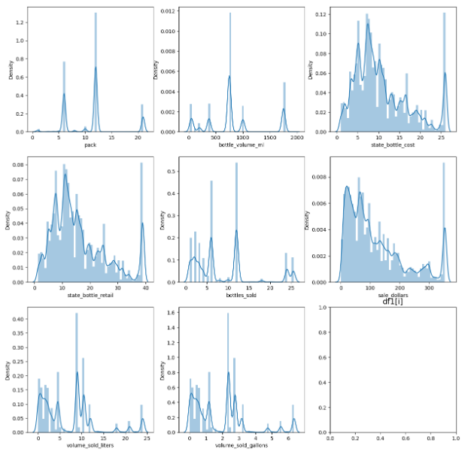
DISTRIBUTION OF VARIABLES

Slide 7
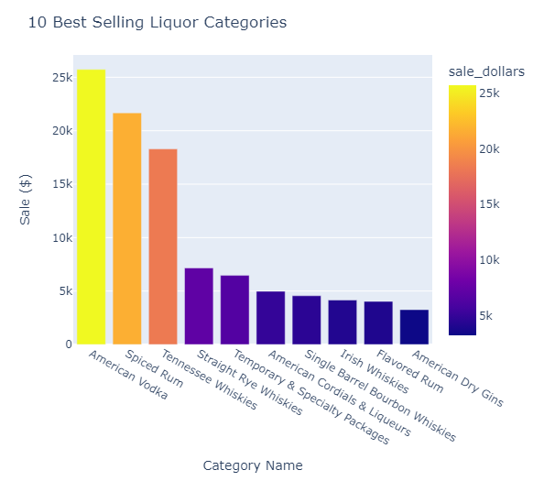
DATA ANALYSIS

Slide 8
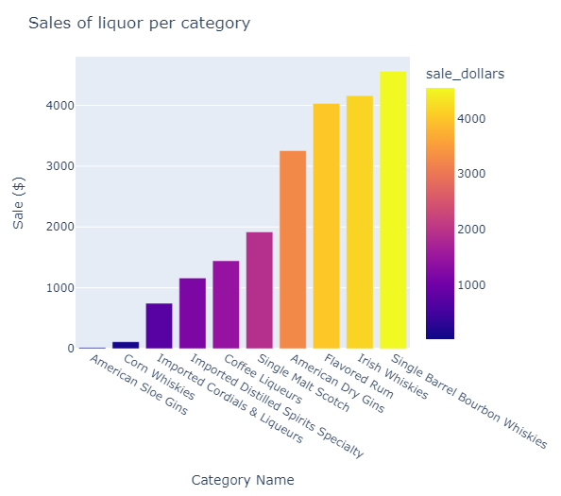

Slide 9
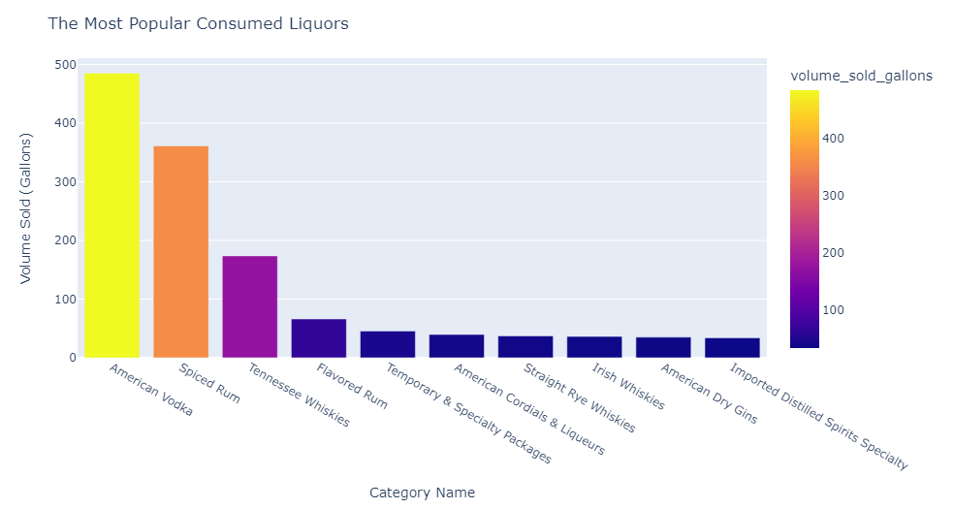

Slide 10
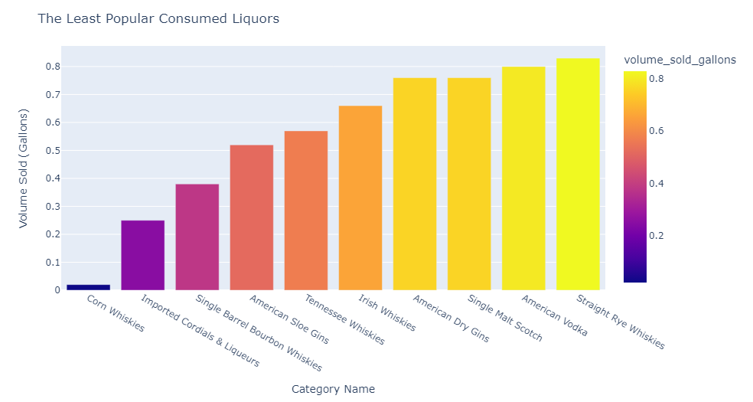

Slide 11
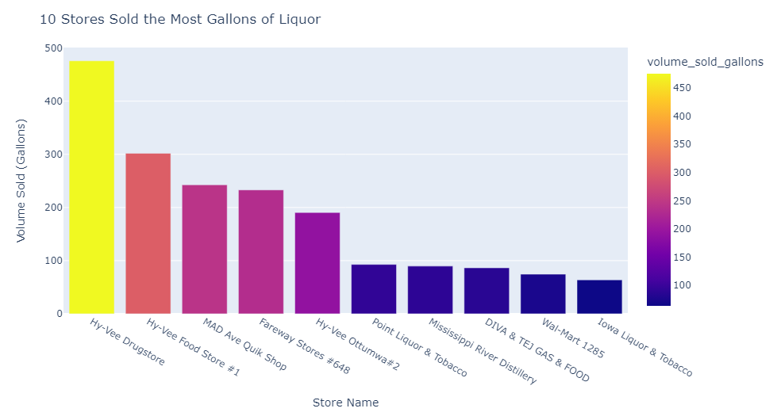

Slide 12
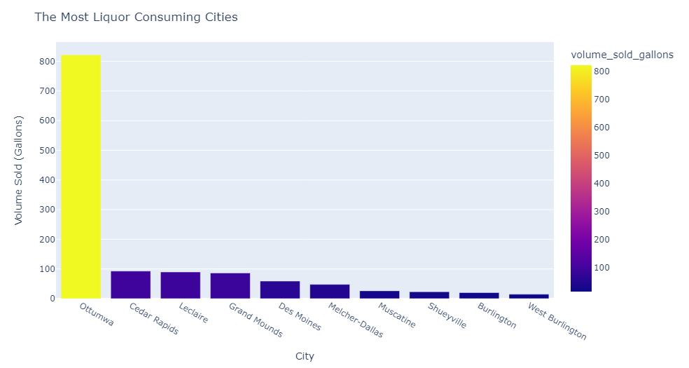

Slide 13
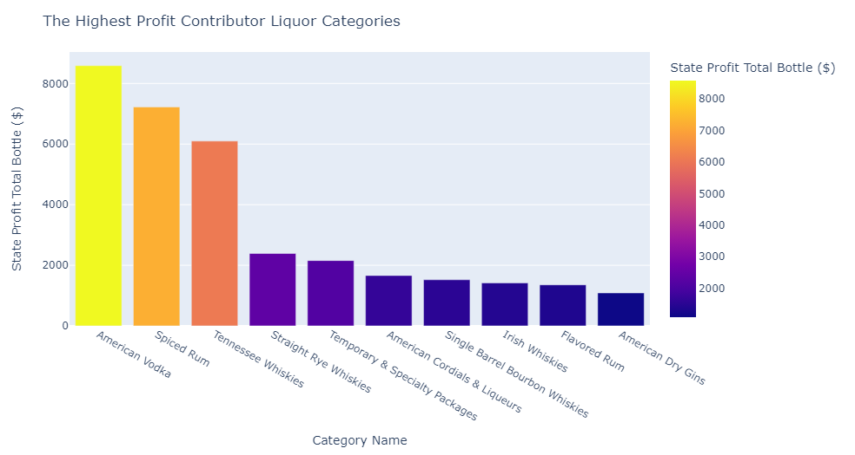

Slide 14
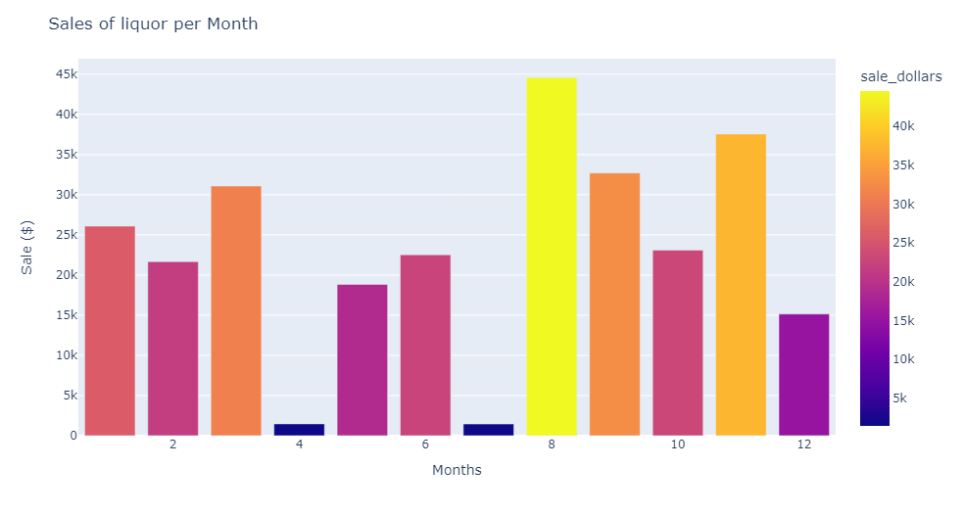

Slide 15
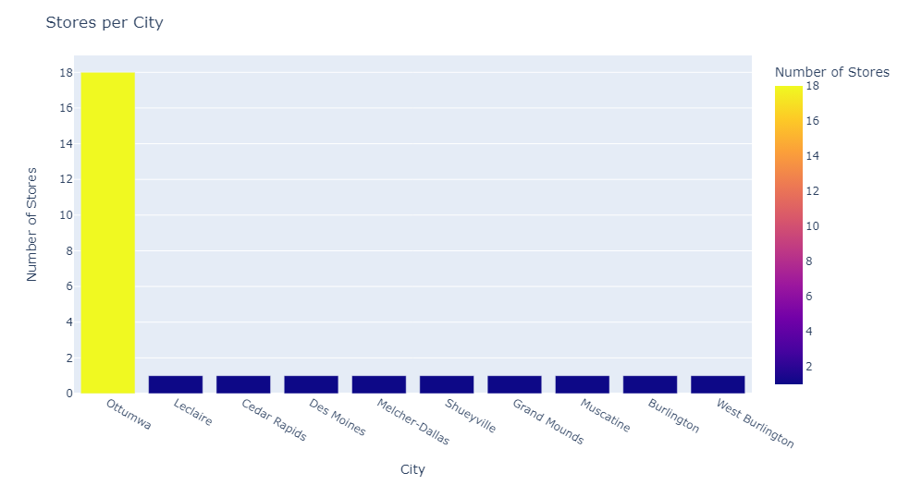

Slide 16
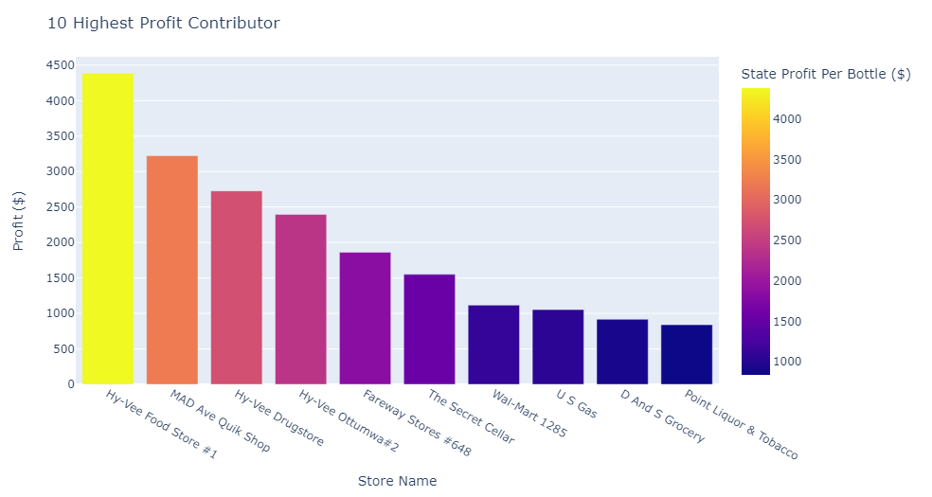

Slide 17
